Slide 1
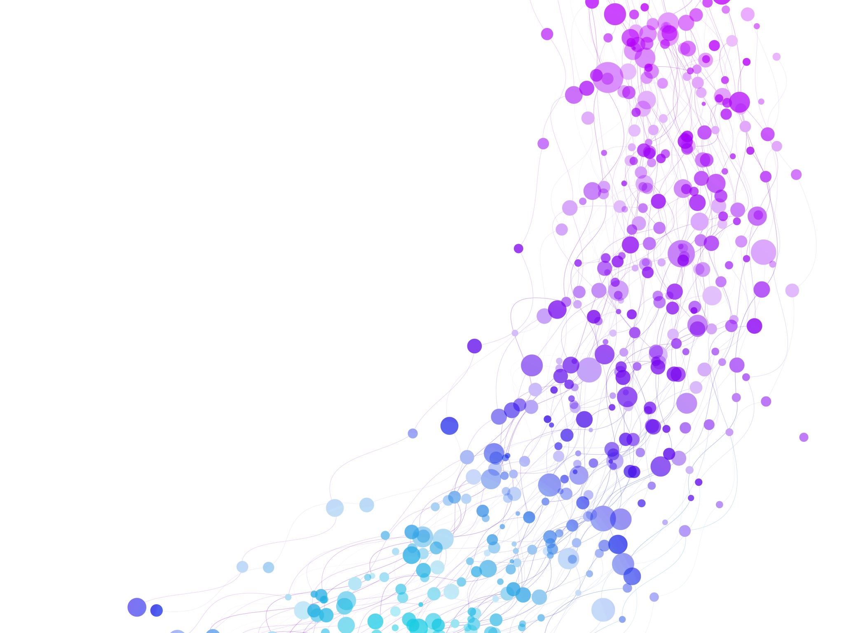


Session Title
One-hot encoding and bag of Words Session No.: 10 Course Name: NLP Course Code: Instructor Name: Mr. Amit Yadav

Slide 2
Insert Review of the key concepts of session no. #

Slide 3
Reflect on the responses of post session activity

Slide 4

💡 "If you have three sentences: "The phone is excellent"
"The battery performance is excellent", "The phone has excellent battery life", how would you represent each word numerically so that computers can understand their meanings?

Slide 5


Ask Questions
Given a set of sentences, how do we represent words numerically so that a computer can process them?
Think: What if we assign each word a unique identifier?
Create the Vocabulary of Unique Words List:
Sentence and word level one-hot encoding techniques

Slide 6
At the end of this session students will be able to
Learning Outcome 1:
Apply One-Hot Encoding and Bag of Words to a small dataset.
Learning Outcome 2:
Analyze the Strengths and Limitations of OHE & BoW

Slide 7
Session Outline
One-hot encoding
2. Sentence and word-level One-Hot encoding
3. Activity-1
4. Limitations of one-hot encoding
5. Bag of words
6. Activity-2 and discussion

Slide 8
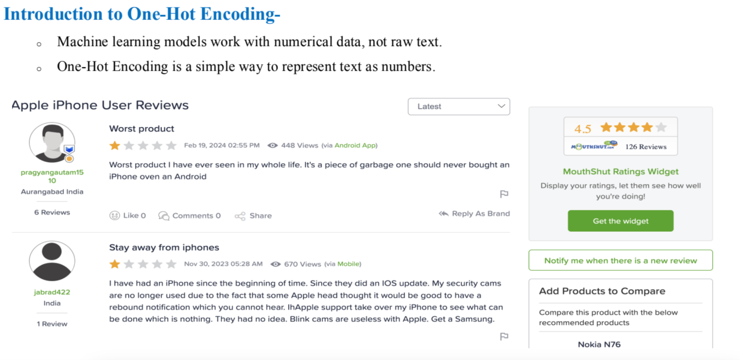
One-Hot encoding (word level and sentence level

Slide 9
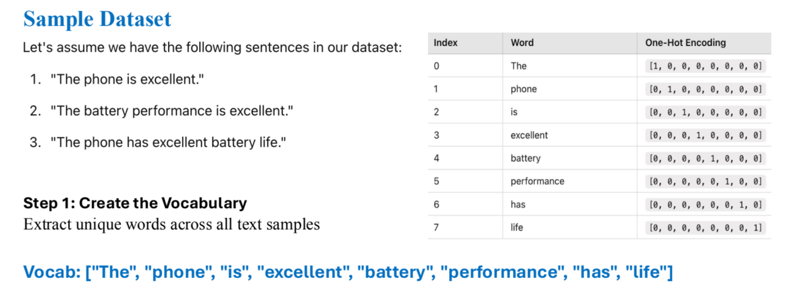
Question 1. Given a set of sentences, how do we represent words numerically so that a computer can process them?
Think: What if we assign each word a unique identifier?
Ans: step 1: Create the Vocabulary of Unique Words List:
Question 2 : How can we represent the first review “The phone is excellent” Think of two techniques.

Slide 10
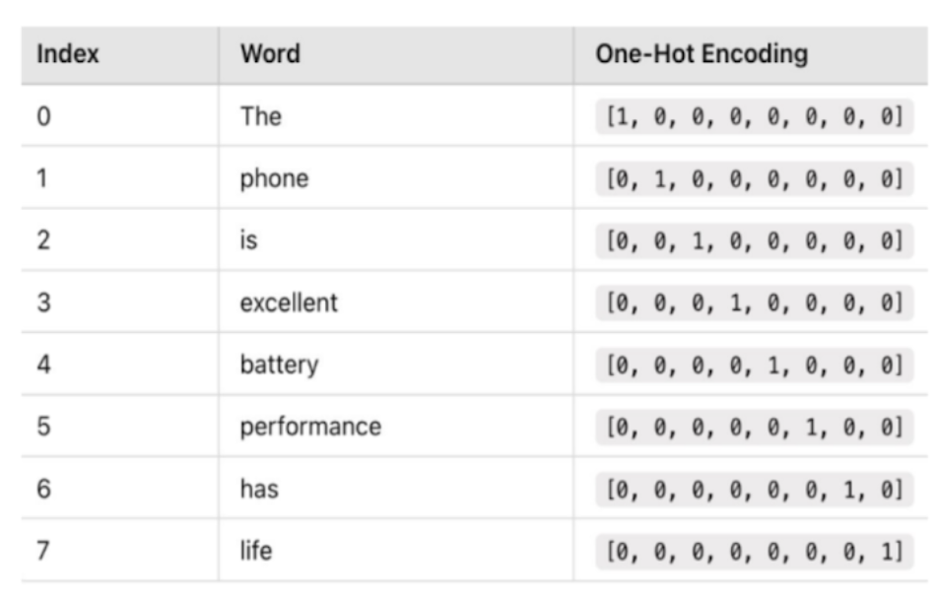
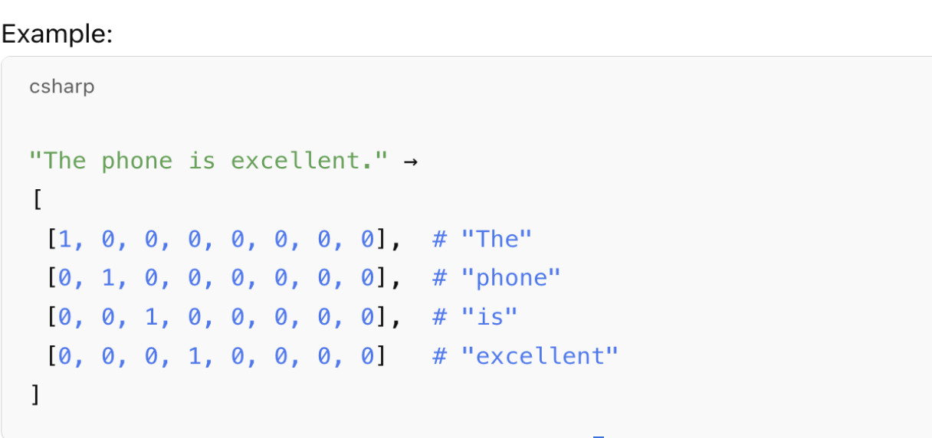
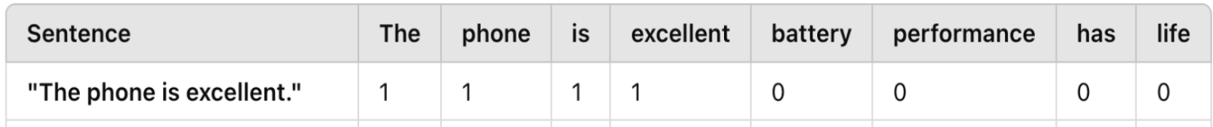
Approach-1 Word-level one-hot encoding
Approach 2: sentence-level one hot encoding

Slide 11
✅ Sentence-level One-Hot Encoding: Used for tasks like text classification and sentiment analysis (treats sentence as a whole).
✅ Word-level One-Hot Encoding: Used for tasks like word embeddings, RNNs, and sequence modeling (treats words individually).

Slide 12


Learning Activity 1
Hands-On, Gamified Learning + Collaborative Group Work
This activity engages students through physical interaction and real-world application of NLP concepts.
Group Formation (Team-Based Learning): Each group will receive printed copies of the following three sentences: S1: "The hotel was great and the food was amazing." ✅ (Positive), S2: "The hotel was bad, and the service was terrible." ❌ (Negative), S3: "Food was good, but the service was slow." 🤔 (Mixed sentiment)
Hands-On Sorting Activity (Gamified Learning) -
Groups compile a common vocabulary from all sentences.
Each group writes down their One-Hot Encoded matrix and compares results.
Reflection & Discussion (Higher-Order Thinking): Now, Imagine You Are Building a Machine Learning Model for Sentiment Analysis. 📌 Your dataset contains 100,000 unique words.
1️⃣ What is the biggest issue with One-Hot Encoding in this case? (Hint: Think about memory usage, vector size, and word meaning loss.)
2️⃣ Why do we treat all words equally in One-Hot Encoding? Is this a problem?
3️⃣ How does One-Hot Encoding fail to capture word relationships (e.g., "good" vs. "excellent")?
4️⃣ Can you think of a better encoding method to solve these problems?

Slide 13
Reflection- Learning Activity 1
High Dimensionality (Curse of Dimensionality): A vocabulary of 10,000 words requires each word to be represented by a 10,000-dimensional vector, with only one active element (1), leading to wasted memory.
Lack of Semantic Meaning: One-hot encoding treats all words as independent entities without any notion of similarity. Example: The words "King" and "Queen" would have completely different one-hot vectors, even though they are
semantically related.
Not Scalable for Large Datasets: In real-world NLP tasks (e.g., training GPT models), vocabularies can reach millions of words, making one-hot encoding impractical.
No Context Awareness: One-hot encoding does not consider word meaning or word usage in different contexts.
Example:
Sentence 1: "He went to the bank to withdraw money."
Sentence 2: "She sat by the bank of the river."
The word "bank" has different meanings but is treated identically in one-hot encoding.

Slide 14
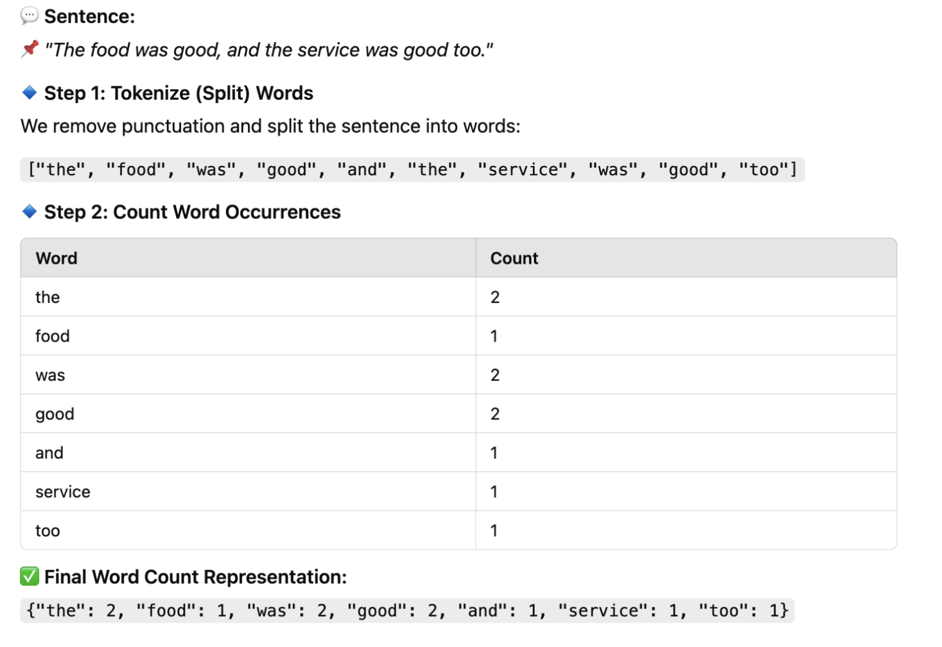
Word count is a basic text processing technique used to determine how many times each word appears in a given document or text corpus.
Bag of Words (word count)

Slide 15

Learning Activity 2
Use the same reviews of Activity 1
Each group will sort words into two categories:
✅ Most frequent words (e.g., "the", "was").
❌ Less frequent words (e.g., "amazing", "slow").
2. Each group counts occurrences and writes the word frequency table on a sheet.
Questions?
What were the most frequent words, and why?
What are the limitations of raw word counts?

Slide 16
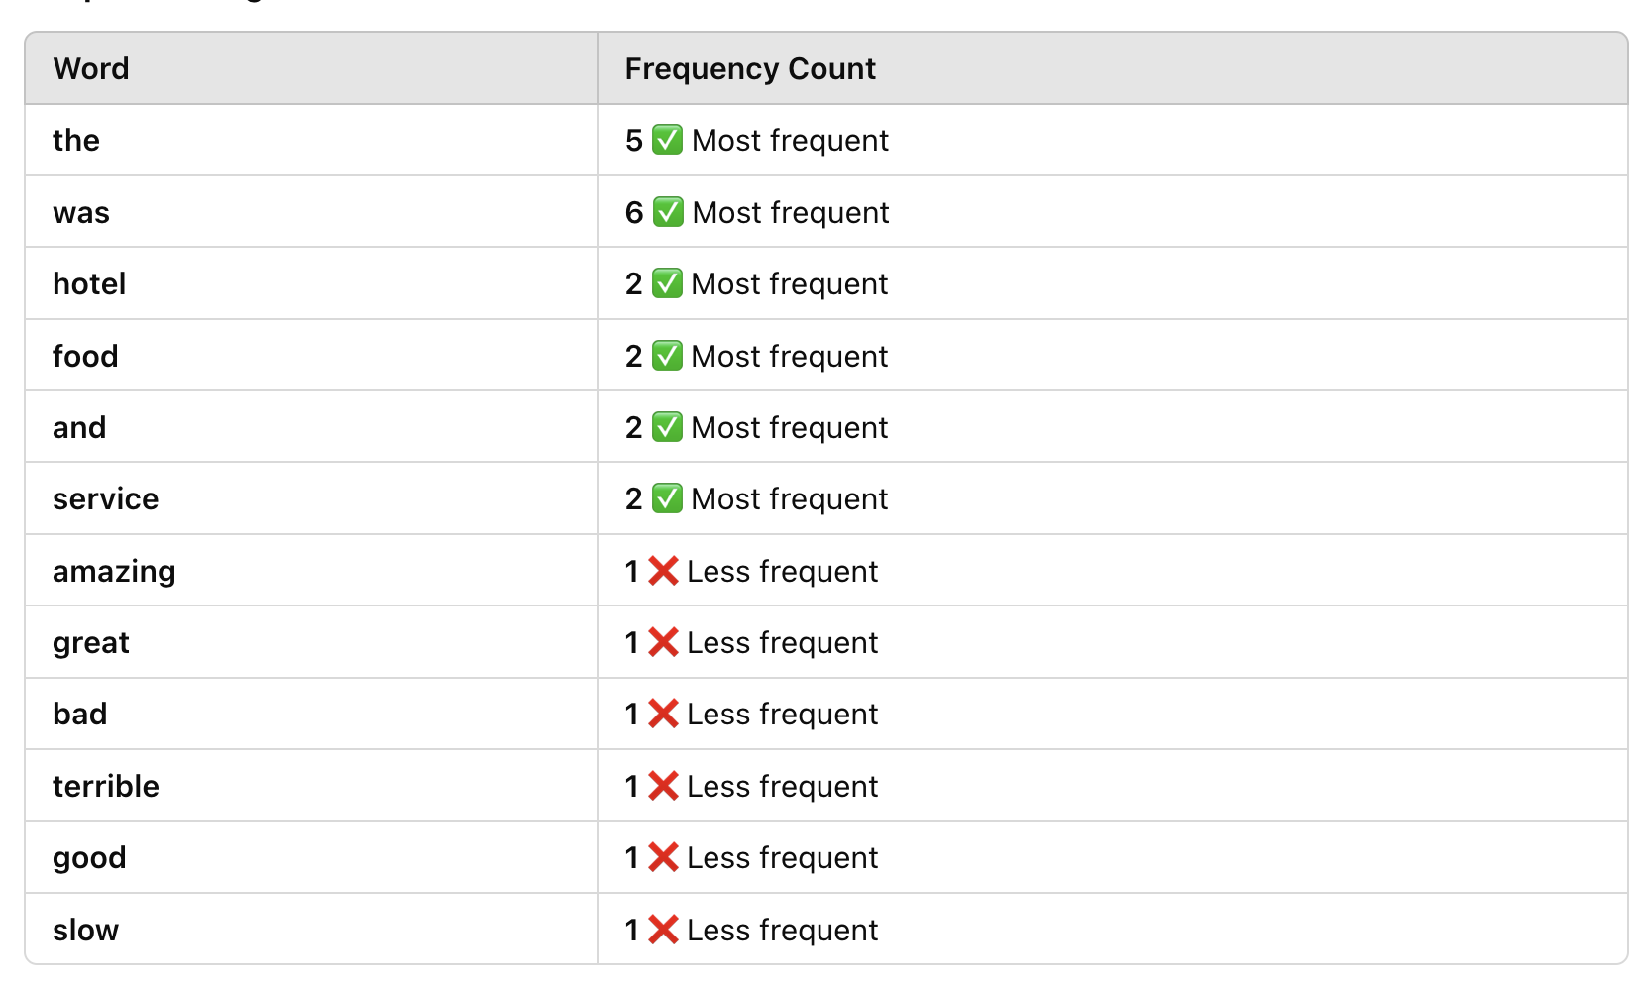
Reflection- Learning Activity 2
Drawbacks of Word Count Method
🚨 Problem 1: Common Words Dominate the Count
"The" and "was" appear frequently but carry no meaning.
Important words like "amazing" and "terrible" appear less frequently but have stronger sentiment.
🚨 Problem 2: Word Count Doesn’t Capture Importance
The word "hotel" appears multiple times but doesn’t tell us if the review is positive or negative.
🚨 Problem 3: No Differentiation Between Important and Unimportant Words
Frequent words ≠ Important words
A rare word might be more meaningful than a commonly used word.

Slide 17
Summary
One-Hot Encoding (OHE) → Represents each word as a binary vector where only one position is "1" and the rest are "0". Bag of Words (BoW) → Converts text into word count frequency vectors, ignoring grammar and word order.
✅ Both techniques are simple and widely used for text representation, but they have major limitations.
🚀 One-Hot Encoding (OHE) Limitations:
✔ High Dimensionality → Large vocab = huge sparse vectors, inefficient memory usage. ✔ Ignores Word Meaning → "good" and "excellent" are treated as unrelated. ✔ No Context Awareness → "Apple (company)" and "apple (fruit)" are encoded the same. ✔ Cannot Handle New Words (OOV) → If a word isn’t in training, it gets ignored.
🚀 Bag of Words (BoW) Limitations:
✔ Ignores Word Order & Grammar → "not bad" and "bad not" get the same representation. ✔ High Dimensionality & Sparse Matrices → Large vocab = memory & computation issues. ✔ Cannot Capture Word Relationships → "awesome" and "fantastic" are treated differently. ✔ Biased Towards Longer Documents → More words = higher word counts = unfair comparisons. ✔ Not Real-Time Friendly → Needs retraining when new words/documents appear.

Slide 18
Ensure attainment of LOs in alignment to the learning activities: outcomes (1-2)
Outcome 1: Apply One-Hot Encoding and Bag of Words to a small dataset.
Outcome 2: Analyze the Strengths and Limitations of OHE & BoW

Slide 19
Discussion on the post session activities

Slide 20
Information to next topic of the course
TF-IDF (Term Frequency-Inverse Document Frequency) is a statistical measure that evaluates how important a word is to a document within a collection (corpus) of documents.

Slide 21

Review and Reflection from students

Slide 22
Activity Answer
Activity-2
Word Count on Multiple Sentences
Now, let’s take three sentences (reviews):
💬 Text Corpus: 1️⃣ "The hotel was great and the food was amazing." 2️⃣ "The hotel was bad, and the service was terrible." 3️⃣ "Food was good, but the service was slow."
Step 1: Tokenize (Extract Words) We split each sentence into words:
"the", "hotel", "was", "great", "and", "the", "food", "was", "amazing"
"the", "hotel", "was", "bad", "and", "the", "service", "was", "terrible"
"food", "was", "good", "but", "the", "service", "was", "slow"

Slide 23
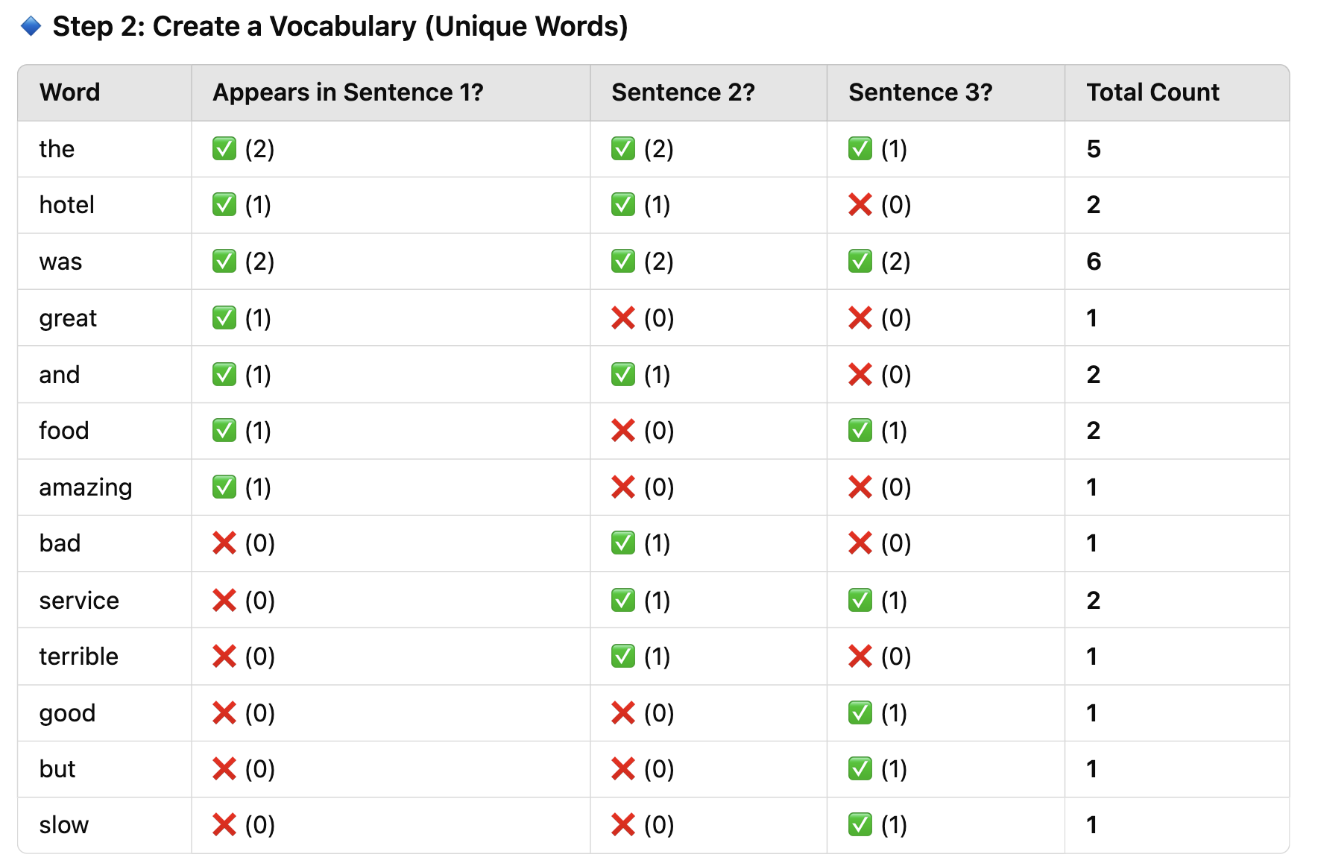

Slide 24
✅ Final Word Count Representation (Across All Sentences): {"the": 5, "hotel": 2, "was": 6, "great": 1, "and": 2, "food": 2, "amazing": 1, "bad": 1, "service": 2, "terrible": 1, "good": 1, "but": 1, "slow": 1}

